Slide 1

Convolutional Neural Network for Movie Poster Genre classification
Presented by : Ron Sider and Jordan Tangy

Slide 2
Steps of our presentation :
Introduction
1.1 What we want to achieve in our project
Our dataset and some examples
Implementation
3.1 Dealing with the dataset (Normalization, splitting,..)
3.2 Convolutional Neural Network Architecture
3.3 Training
3.4 Results (Model Accuracy and Model Loss)
3.5 Some examples of testing
4. Conclusion

Slide 3
1- Introduction
1.1 What we want to achieve in our project

Slide 4
Given a large data set of Movie Poster, we want to create a model that will be able to classify the movie posters into there correct genres.
For such a task we downloaded a data Set from Kaggle which contains :
A file of 41K different movie posters.
A csv file which contains all the metadata and the classification of each poster.
We used the Google Colab platform to carry out this work.

Slide 5
2 - Our dataset and some examples

Slide 6
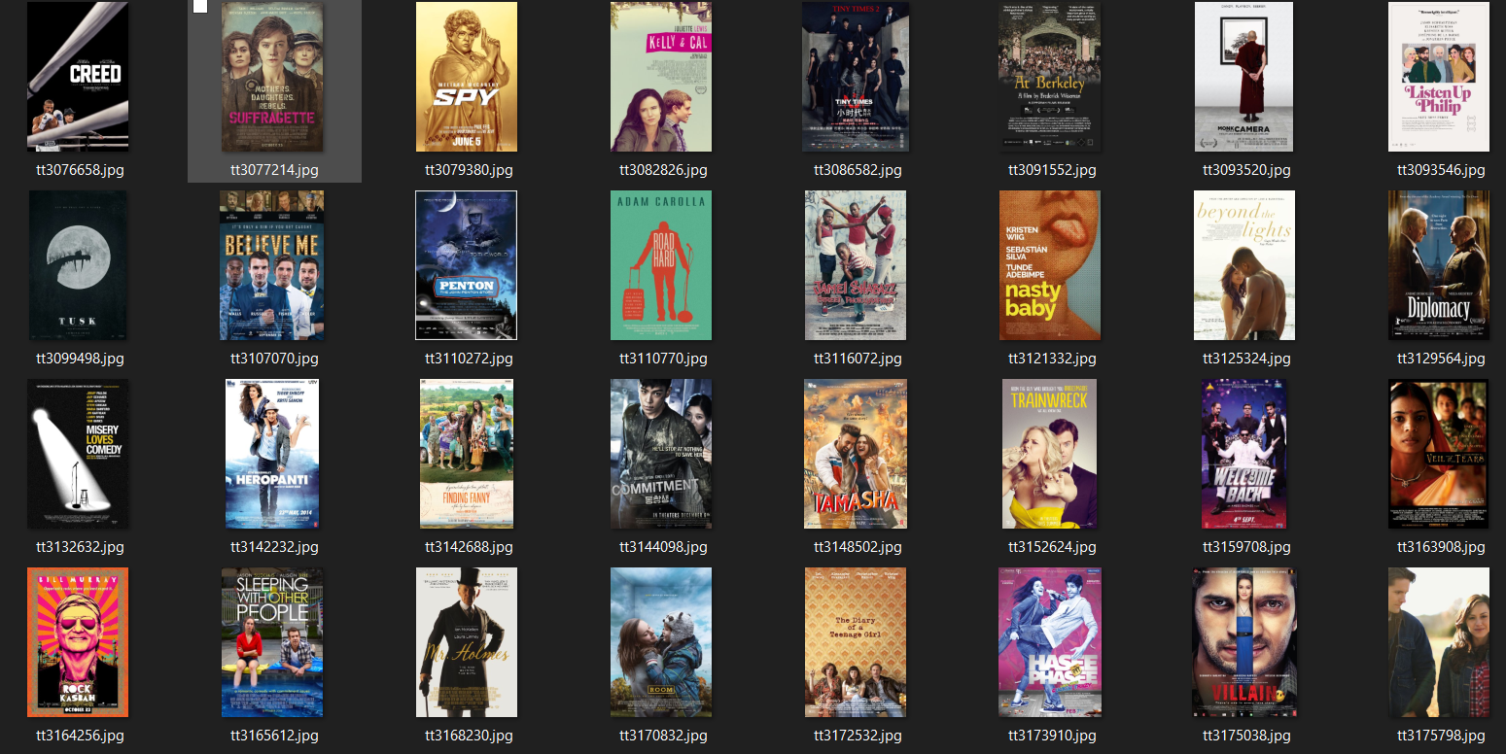
A sample from our images file

Slide 7
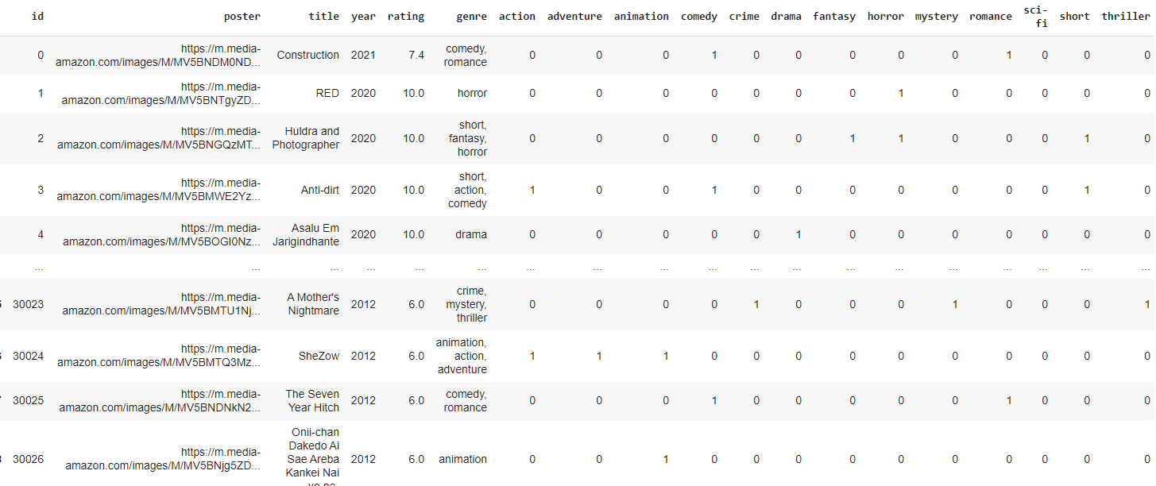
A sample from our csv file

Slide 8
Implementation
3.1 Dealing with the dataset (Normalization, splitting,..)

Slide 9
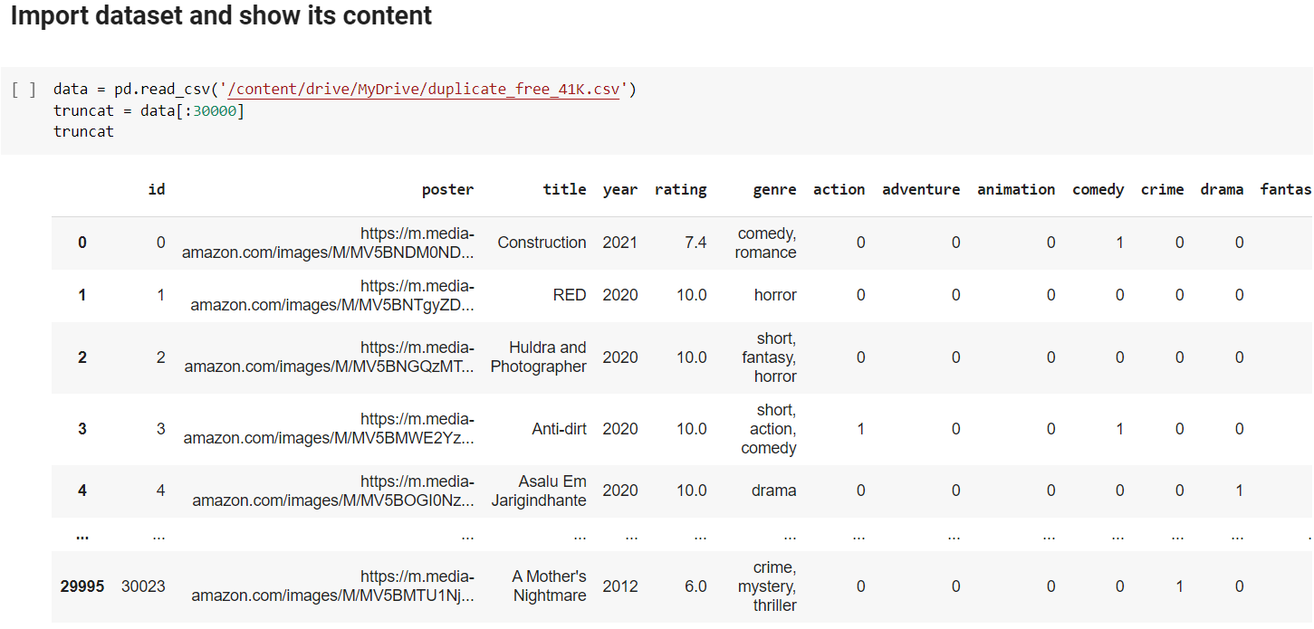
Converting csv file to pandas Dataframe

Slide 10
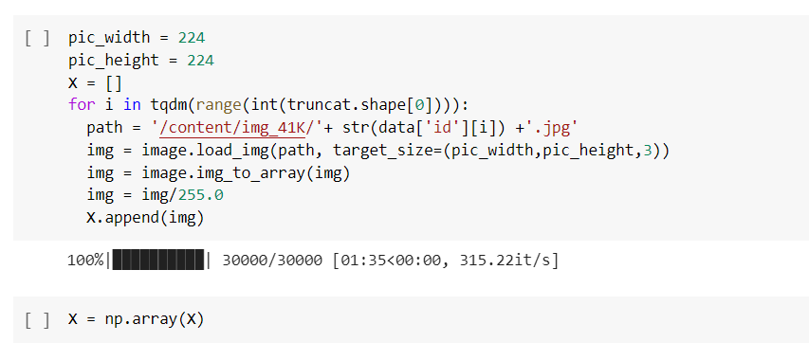
Insertion of the pictures into a manageable array

Slide 11
Insertion of the pictures into a manageable array

Slide 12
Rearranging y data by dropping irrelevant fields
Our aim is to “cut” the data frame and get the array representing the classification of the movies (1’s and 0’s only)

Slide 13
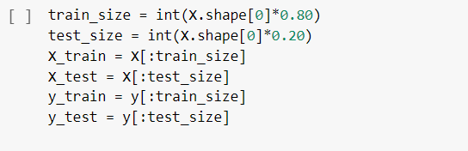
Splitting the dataset into train set and test set
Training data size = 80%
Testing data size = 20%

Slide 14
Implementation
3.2 Convolutional Neural Network Architecture

Slide 15
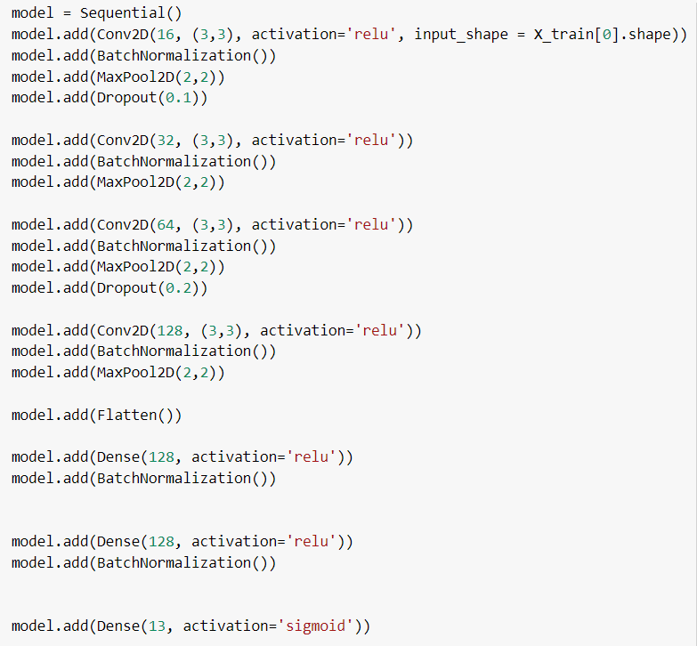
ConvNet Architecture
}
16 filters, each one of size 3x3 (Relu Activation Function)
Batch Normalization → Maxpooling 2x2 → 10% DropOut
}
32 filters, each one of size 3x3 (Relu Activation Function)
Batch Normalization → Maxpooling 2x2
}
64 filters, each one of size 3x3 (Relu Activation Function)
Batch Normalization → Maxpooling 2x2 → 20% DropOut
}
128 filters, each one of size 3x3 (Relu Activation Function)
Batch Normalization → Maxpooling 2x2
}
}
Flatten Layer
Dense Layer (128 neurons) , Relu Activation Function Batch Normalization
}
Dense Layer (128 neurons) , Relu Activation Function Batch Normalization
}
Output Layer (13 neurons), Sigmoid Activation Function (We assumed that there are no relationship between genres)

Slide 16
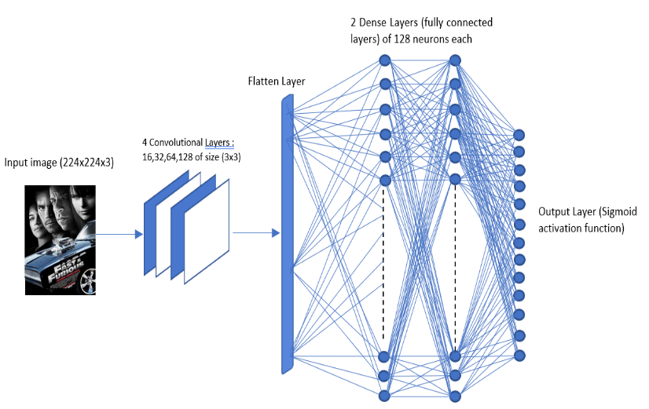
ConvNet Visualization

Slide 17
Implementation
3.3 Training

Slide 18
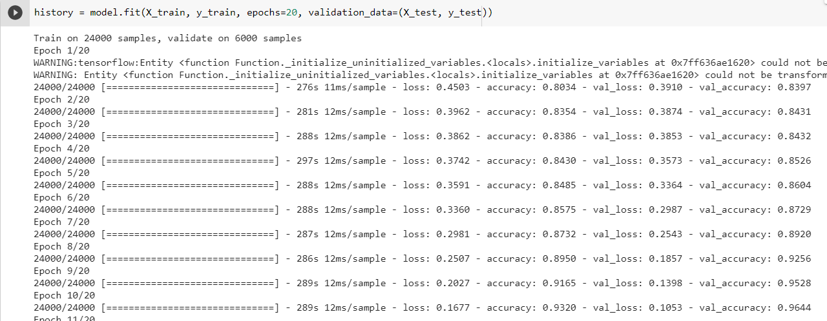
Compiling and training the model

Slide 19
Compiling and training the model
Optimizer :
Adam Optimizer : Empirically, Adam gave use better results than other optimizers
Adam optimizers adjusts its learning during training and is fast compared to other algorithms.
Loss function:
Binary Cross entropy loss function does not affect other output values. And that is exactly what we need. Multi-label classification means that the output values are not impacted one by the other (unlike multi-class classification). And because of that loss needs to be calculated for each genre independently to other genres, the most effictive loss function to use was binary cross entropy.

Slide 20
Compiling and training the model
-Training of 24000 samples, validating on 6000 samples
-20 epochs

Slide 21
Implementation
3.4 Results (Model Accuracy and Model Loss)

Slide 22
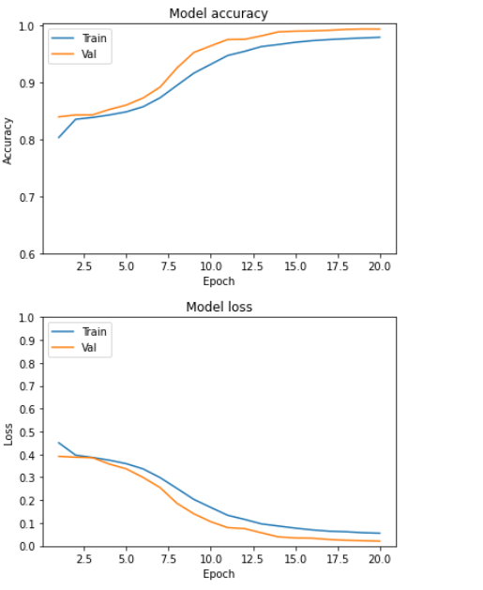
Plots of our results
It seems that validation accuracy is higher than training accuracy because when we use dropout , we use it only on the training and not on the validation.
For the loss, the validation loss is smaller than the training loss for the same reason mentioned above.

Slide 23
Implementation
3.5 Some examples of testing

Slide 24
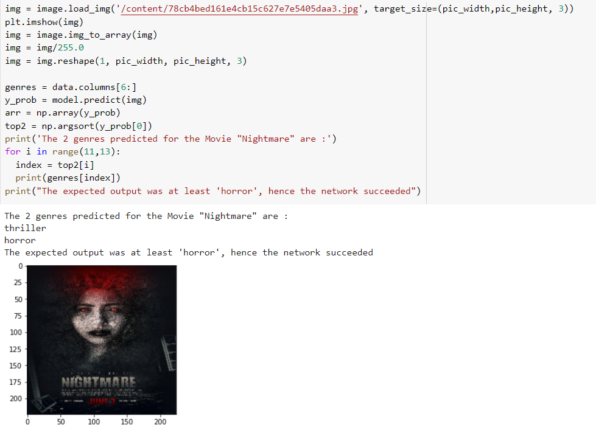
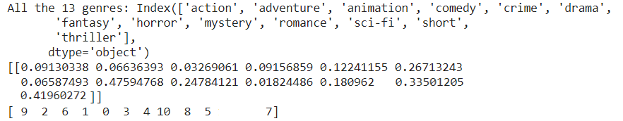
Testing Examples

Slide 25
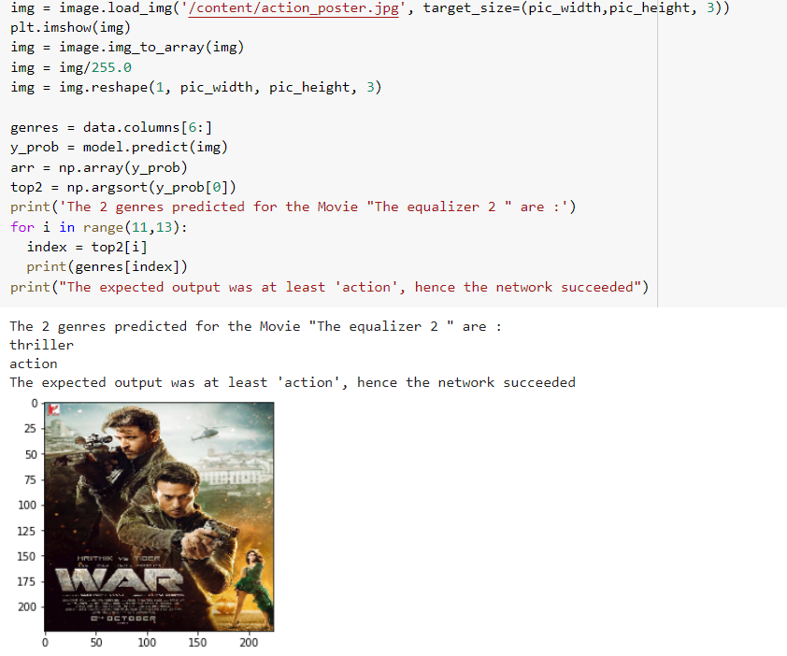
Testing Examples

Slide 26
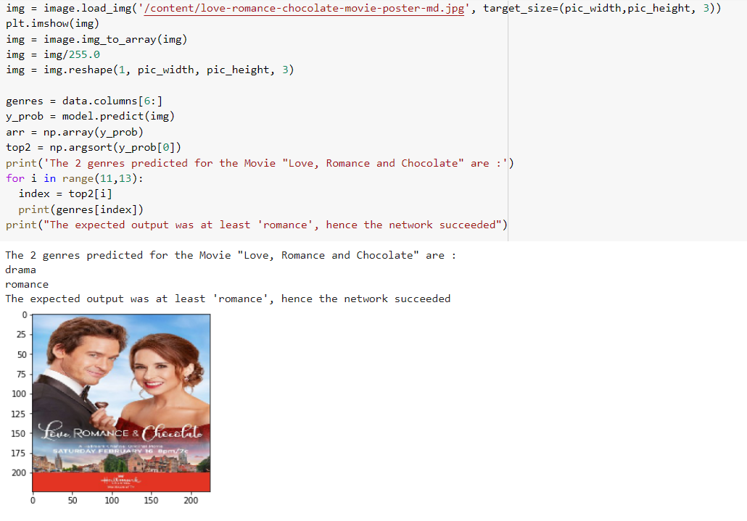
Testing Examples

Slide 27
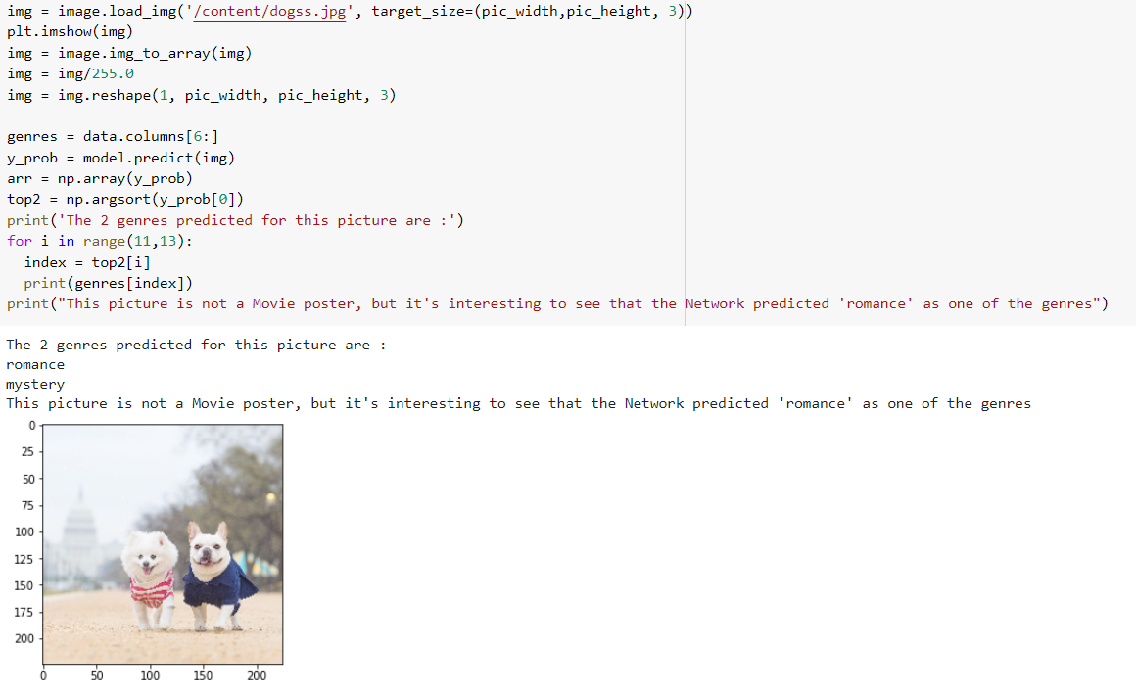
Interesting output
This picture is not a movie Poster.
We wanted to challenge the Network on a picture that shows two dogs one next to the other.
As humans, we can see “ a couple “ of dogs, and it is interesting to see that the network classified this picture as a ‘romance’.
It seems like the Network has identified the pattern of ‘couple’ in romance movie posters and that might be the reason why this picture is classified as ‘romance’.

Slide 28
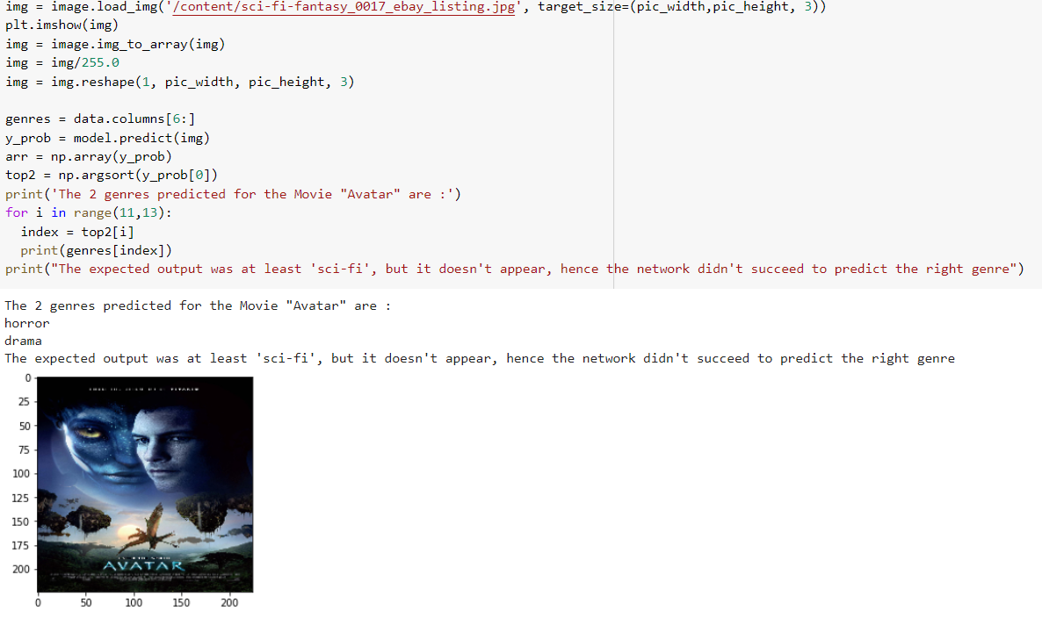
Testing Examples

Slide 29
4. Conclusion

Slide 30
The CNN is accurate at a rate of 97% !
Overall, the CNN gives accurate predictions and even showed us some kind of “creativity”.
Some of our results were also achieved through trial and error (Such as dropout percentage, how many epochs, how many neurons in the Dense Layer…)

Slide 31
Thank you for listening !

